Slide 1

Database Design Final Project Report CAB Management system

Slide 2
INDEX
INTRODUCTION
REQUIREMENTS
ENTITIES & RELATION
ASSUMPTIONS
FUNCTIONAL DEPENDENCIES
FINAL RELATIONAL SCHEMA
ER DIAGRAM
SQL STATEMENTS
TABLES AND THEIR VALUES
SQL QUERIES
CONCLUSION
BIBLIOGRAPHY

Slide 3
Introduction and project scope
We have planned to produce a cab management system. In our system, the customer can book a cab as per their needs and location. In our system , we are providing our customers flexibility for choosing cab based on drop-of locations and journey. Also the customers who hold a membership-card generated by us would experience discounts on cab booking.
A Database is a collection of well defined, inter-connected information about a particular enterprise.
A Database Management System (DBMS) is software designed to store, retrieve, define, and manage data in a database.
A Relational Database Management System (RDBMS or just RDB) is a common type of database that stores data in tables, so it can be used in relation to other stored datasets.

Slide 4
Entities
Customer_info entity will store the details of the customer like their serial number, name , email id etc .
The cab_info entity would be storing the various category of cabs with attributes like car plate number, company name, model , RC number etc.
A traveller starts its journey with booking a cab. So the journey entity covers attributes like Customer serial number, driver id number , start location, final location etc.
Driver_info entity ensures customer’s safety and satisfaction, dealing with attributes like driver id no, name, license no, phone number , address etc
Medical_info entity is in alignment with the information required by storing the info of medical status of the driver assigned in attributes like height of driver, blood group , any illness etc
Membership_program entity for enjoying the premium facilities given by the agency like remote area pick-ups , refreshments etc and also enjoying heavy discounts membership programme is built. Attributes like Type, Months_Duration , charges , discount % , insurance_amount etc store the info for membership card.

Slide 5
relations
Customer Information to Cab information: Every customer enter the details during the registration in cab agency . On the basis of the information the required cab is alloted for the journey. The info of various cab available in the agency is stored in cab information table .The relation name is ‘Rides’.
Cab information to driver information: When the cab is alloted to a customer , a driver is also assigned with the cab for the journey. The info about the driver is stored in driver information table. The relation name is ‘Drives’
Customer information to journey: When a customer books a cab, he/she filles the required customer details which are stored in customer information table. The info about the pick up points and drop off ,amount ,driver allotment etc, i.e info about journey is stored in journey table. The relation name is ‘travels’.
Driver to Medical report: As ensuring safe journey is an important part of cab booking agency. So for the allotment of the driver certain info about driver and their medical status is stored in Medical report table. The relation name is ‘Acquires’
Customer to Membership: If a customer is willing to be a member of cab booking agency and enjoy the privileges associated with the membership , they have to enroll in membership program. Details of the members of the agency is stored in membership program table. The relation name is ‘Purchases’.

Slide 6
Functional dependencies
The functional dependency is a relationship that exists between two attributes. The left side of FD is known as a determinant, the right side of the production is known as a dependent.
Customer_info : Cus_Serial_Num → Cus_Name, Cus_Phone_No, Cus_Start_Loc, Cus_Final_Loc, Cus_Email, Membership_Type, Membership_StartTime, Membeship_ExpiryTime;
Car_info : Car_Plate_No → Car_Name, Model_No, Engine_Number, Insurance_No, Pollution_Check, No_of_Seats, Car_Loc;
Medical_report : Report_No → Driver_Height, Eyesight_Left, Eyesight_Right, Birth_Mark, Any_Illness;
Driver_Info : Id_No → Driver_Name,Driving_Lic_No,Phone_No , Adress, Gender, Age, Car_Plate_No;
Journey : Cus_Serial_Num → Journey_Id, Cus_Serial_num, Driver_Id_No, Car_Plate_No, Cus_Start_Loc, Cus_Final_Loc, Distance_Travelled, Total_Fare;
Membership_Program : Type → Months_Duration, Charges, Discount_Percent, Rides_free, Insurance_Amount;

Slide 7
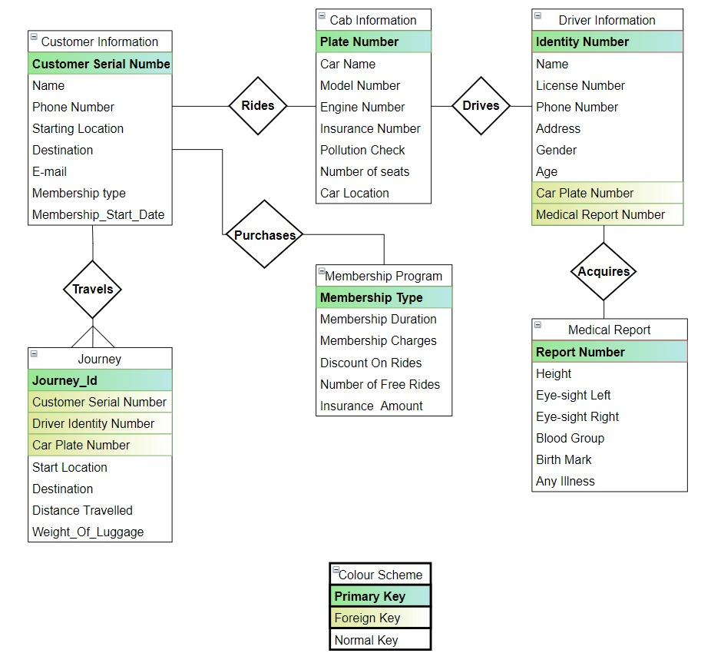
Er diagram

Slide 8
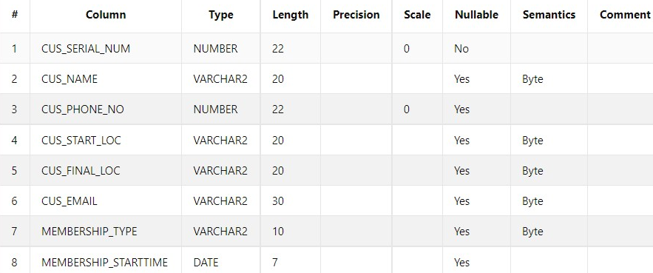
Sql queries and their relational schema
a) Customer_Info:
create table Customer_Info
(Cus_Serial_Num int PRIMARY KEY,
Cus_Name varchar(20),
Cus_Phone_No int,
Cus_Start_Loc varchar(20),
Cus_Final_Loc varchar(20),
Cus_Email varchar(30),
Membership_type varchar(10),
Membership_StartTime Date
);

Slide 9
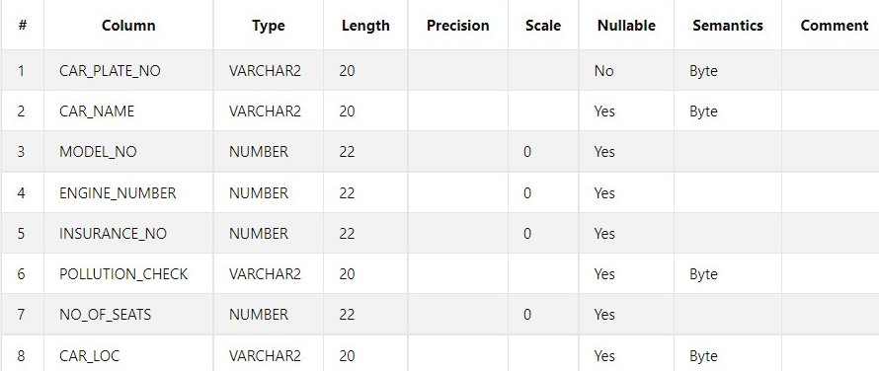
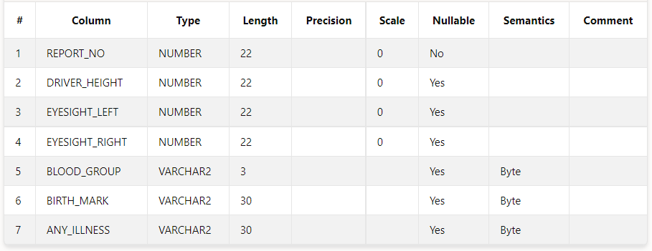
.
b) Car_info:
create table Car_Info
(Car_Plate_No varchar(20) PRIMARY KEY,
Car_Name varchar(20),
Model_No int,Engine_Number int,
Insurance_No int,
Pollution_Check varchar(20),
No_of_Seats int,
Car_loc varchar(20));
c) Medical_Report:
create table Medical_Report
(Report_No int PRIMARY KEY,
Driver_Height int,
Eyesight_Left int,
Eyesight_Right int,
Blood_Group varchar(3),
Birth_Mark varchar(30),
Any_Illness varchar(30));

Slide 10
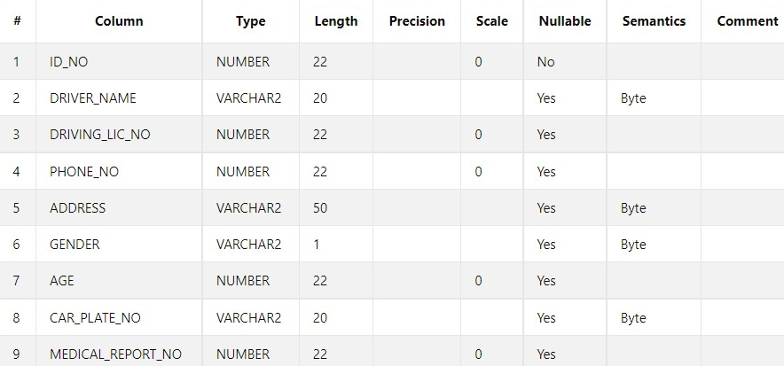
.
d) Driver_info:
create table Driver_Info
(Id_No int PRIMARY KEY,
Driver_Name varchar(20),
Driving_Lic_No int,
Phone_No int,
Address varchar(50),
Gender varchar(1),
Age int,
Car_Plate_No varchar(20) ,
FOREIGN KEY (Car_Plate_No)
REFERENCES Car_Info(Car_Plate_No),
Medical_Report_No int,
FOREIGN KEY (Medical_Report_No)
REFERENCES Medical_Report(Report_No))

Slide 11
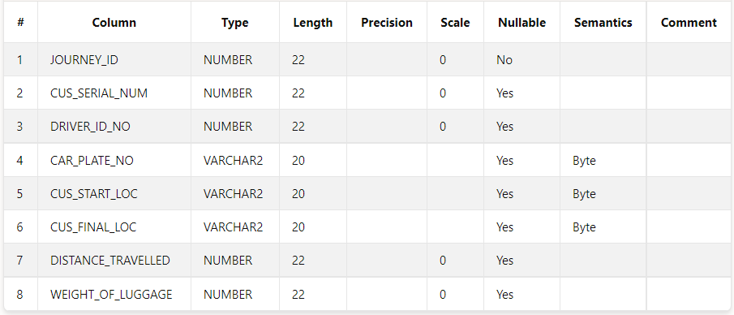
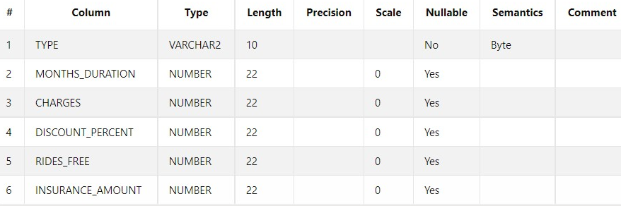
.
e) Journey:
create table Journey
(Journey_Id int Primary Key,
Cus_Serial_Num int,
FOREIGN KEY (Cus_Serial_Num)
REFERENCES Customer_Info(Cus_Serial_Num),
Driver_Id_No int,
FOREIGN KEY (Driver_Id_No)
REFERENCES Driver_Info(Id_No),
Car_Plate_No varchar(20),
FOREIGN KEY (Car_Plate_No)
REFERENCES Car_Info(Car_Plate_No),
Cus_Start_Loc varchar(20),
Cus_Final_Loc varchar(20),
Distance_Travelled int,
Weight_of_Luggage int
)
f) Membership_Program:
create table Membership_Program
(Type varchar(10) Primary Key,
Months_Duration int,
Charges int,
Discount_Percent int,
Rides_free int,
Insurance_Amount int);

Slide 12
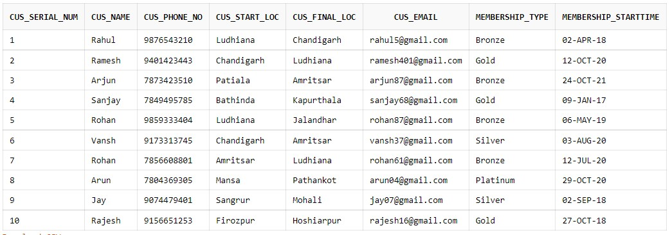
Insertion statements, with their tables and values
a.) Customer_info
insert all
into Customer_Info Values(1,'Rahul',9876543210,'Ludhiana','Chandigarh','rahul5@gmail.com','Bronze',TO_DATE('02.04.2018','DD.MM.YYYY’))
into Customer_Info Values(2,'Ramesh',9401423443,'Chandigarh','Ludhiana','ramesh401@gmail.com','Gold',TO_DATE('12.10.2020','DD.MM.YYYY'))
into Customer_Info Values(3,'Arjun',7873423510,'Patiala','Amritsar','arjun87@gmail.com','Bronze',TO_DATE('24.10.2021','DD.MM.YYYY'))
into Customer_Info Values(4,'Sanjay',7849495785,'Bathinda','Kapurthala','sanjay68@gmail.com','Gold',TO_DATE('09.01.2017','DD.MM.YYYY'))
into Customer_Info Values(5,'Rohan',9859333404,'Ludhiana','Jalandhar','rohan87@gmail.com','Bronze',TO_DATE('06.05.2019','DD.MM.YYYY'))
into Customer_Info Values(6,'Vansh',9173313745,'Chandigarh','Amritsar','vansh37@gmail.com','Silver',TO_DATE('03.08.2020','DD.MM.YYYY'))
into Customer_Info Values(7,'Rohan',7856608801,'Amritsar','Ludhiana','rohan61@gmail.com','Bronze',TO_DATE('12.07.2020','DD.MM.YYYY'))
into Customer_Info Values(8,'Arun',7804369305,'Mansa','Pathankot','arun04@gmail.com','Platinum',TO_DATE('29.10.2020','DD.MM.YYYY'))
into Customer_Info Values(9,'Jay',9074479401,'Sangrur','Mohali','jay07@gmail.com','Silver',TO_DATE('02.09.2018','DD.MM.YYYY'))
into Customer_Info Values(10,'Rajesh',9156651253,'Firozpur','Hoshiarpur','rajesh16@gmail.com','Gold',TO_DATE('27.10.2018','DD.MM.YYYY'))
select * from Dual;

Slide 13
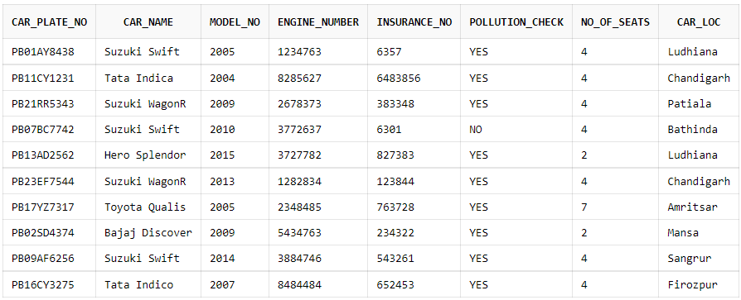
b) Car_Info:
insert all
into Car_Info Values('PB01AY8438', 'Suzuki Swift', 2005, 1234763, 0000006357, 'YES', 4, 'Ludhiana')
into Car_Info Values('PB11CY1231', 'Tata Indica', 2004, 8285627, 0006483856, 'YES', 4, 'Chandigarh')
into Car_Info Values('PB21RR5343', 'Suzuki WagonR', 2009, 2678373, 0000383348, 'YES', 4, 'Patiala')
into Car_Info Values('PB07BC7742', 'Suzuki Swift', 2010, 3772637, 0000006301, 'NO', 4, 'Bathinda')
into Car_Info Values('PB13AD2562', 'Hero Splendor', 2015, 3727782, 0000827383, 'YES', 2, 'Ludhiana')
into Car_Info Values('PB23EF7544', 'Suzuki WagonR', 2013, 1282834, 0000123844, 'YES', 4, 'Chandigarh')
into Car_Info Values('PB17YZ7317', 'Toyota Qualis', 2005, 2348485, 0000763728, 'YES', 7, 'Amritsar')
into Car_Info Values('PB02SD4374', 'Bajaj Discover', 2009, 5434763, 0000234322, 'YES', 2, 'Mansa')
into Car_Info Values('PB09AF6256', 'Suzuki Swift', 2014, 3884746, 0000543261, 'YES', 4, 'Sangrur')
into Car_Info Values('PB16CY3275', 'Tata Indico', 2007, 8484484, 0000652453, 'YES', 4, 'Firozpur')
select * from Dual

Slide 14
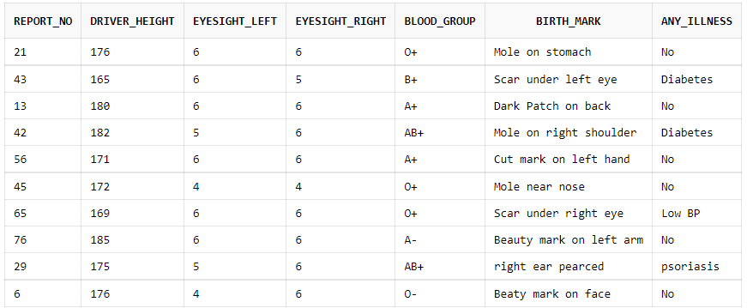
c) Medical_Report:
insert all
into Medical_Report Values(0021, 176, 6, 6, 'O+', 'Mole on stomach', 'No')
into Medical_Report Values(0043, 165, 6, 5, 'B+', 'Scar under left eye', 'Diabetes')
into Medical_Report Values(0013, 180, 6, 6, 'A+', 'Dark Patch on back ', 'No')
into Medical_Report Values(0042, 182, 5, 6, 'AB+', 'Mole on right shoulder', 'Diabetes')
into Medical_Report Values(0056, 171, 6, 6, 'A+', 'Cut mark on left hand', 'No')
into Medical_Report Values(0045, 172, 4, 4, 'O+', 'Mole near nose', 'No')
into Medical_Report Values(0065, 169, 6, 6, 'O+', 'Scar under right eye', 'Low BP')
into Medical_Report Values(0076, 185, 6, 6, 'A-', 'Beauty mark on left arm', 'No')
into Medical_Report Values(0029, 175, 5, 6, 'AB+', 'right ear pierced', 'psoriasis')
into Medical_Report Values(0006, 176, 4, 6, 'O-', 'Beaty mark on face', 'No')
select * from Dual

Slide 15
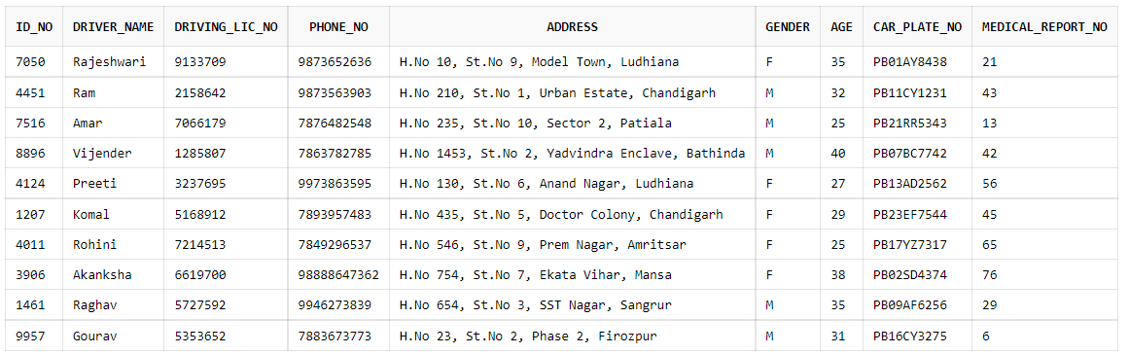
d) Driver_Info:
insert all
into Driver_Info Values(7050, 'Rajesh', 9133709, 9873652636, 'H.No 10, St.No 9, Model Town, Ludhiana', 'M', 35, 'PB01AY8438', 0021)
into Driver_Info Values(4451, 'Ram', 2158642, 9873563903, 'H.No 210, St.No 1, Urban Estate, Chandigarh', 'M', 32, 'PB11CY1231', 0043)
into Driver_Info Values(7516, 'Amar', 7066179, 7876482548, 'H.No 235, St.No 10, Sector 2, Patiala', 'M', 25, 'PB21RR5343', 0013)
into Driver_Info Values(8896, 'Vijender', 1285807, 7863782785, 'H.No 1453, St.No 2, Yadvindra Enclave, Bathinda', 'M', 40, 'PB07BC7742', 0042)
into Driver_Info Values(4124, 'Preeti', 3237695, 9973863595, 'H.No 130, St.No 6, Anand Nagar, Ludhiana', 'F', 27, 'PB13AD2562', 0056)
into Driver_Info Values(1207, 'Komal', 5168912, 7893957483, 'H.No 435, St.No 5, Doctor Colony, Chandigarh', 'F', 29, 'PB23EF7544', 0045)
into Driver_Info Values(4011, 'Rohan', 7214513, 7849296537, 'H.No 546, St.No 9, Prem Nagar, Amritsar', 'M', 25, 'PB17YZ7317', 0065)
into Driver_Info Values(3906, 'Akash', 6619700, 98888647362, 'H.No 754, St.No 7, Ekata Vihar, Mansa', 'M', 38, 'PB02SD4374', 0076)
into Driver_Info Values(1461, 'Kunal', 5727592, 9946273839, 'H.No 654, St.No 3, SST Nagar, Sangrur', 'M', 35, 'PB09AF6256', 0029)
into Driver_Info Values(9957, 'Gourav', 5353652, 7883673773, 'H.No 23, St.No 2, Phase 2, Firozpur', 'M', 31, 'PB16CY3275', 0006)
select * from Dual

Slide 16
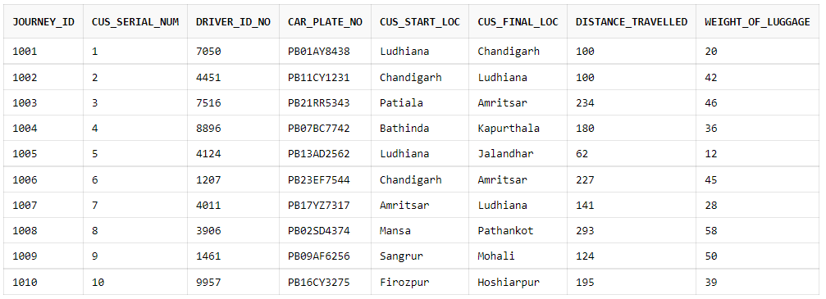
e) Journey:
insert all
into Journey Values(1001,1, 7050, 'PB01AY8438', 'Ludhiana','Chandigarh',100,20)
into Journey Values(1002,2, 4451, 'PB11CY1231', 'Chandigarh','Ludhiana',100,42)
into Journey Values(1003,3, 7516, 'PB21RR5343', 'Patiala','Amritsar',234,46)
into Journey Values(1004,4, 8896, 'PB07BC7742', 'Bathinda','Kapurthala',180,36)
into Journey Values(1005,5, 4124, 'PB13AD2562', 'Ludhiana','Jalandhar',62,12)
into Journey Values(1006,6, 1207, 'PB23EF7544', 'Chandigarh','Amritsar',227,45)
into Journey Values(1007,7, 4011, 'PB17YZ7317', 'Amritsar','Ludhiana',141,28)
into Journey Values(1008,8, 3906, 'PB02SD4374', 'Mansa','Pathankot',293,58)
into Journey Values(1009,9, 1461, 'PB09AF6256', 'Sangrur','Mohali',124,50)
into Journey Values(1010,10, 9957, 'PB16CY3275', 'Firozpur','Hoshiarpur',195,39)
select * from Dual

Slide 17
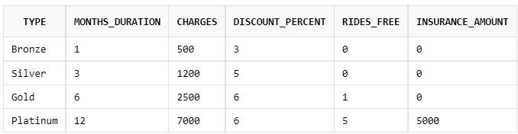
f) Membership_Program:
Insert all
into Membership_Program Values('Bronze',1,500,3,0,0)
into Membership_Program Values('Silver',3,1200,5,0,0)
into Membership_Program Values('Gold',6,2500,6,1,0)
into Membership_Program Values('Platinum',12,7000,6,5,5000)
Select * from Dual;

Slide 18
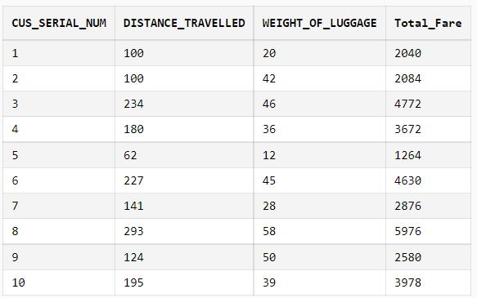
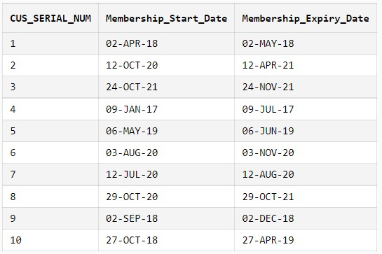
Sql queries
a. select Cus_Serial_Num, Distance_Travelled, Weight_of_Luggage, Distance_Travelled*20) +(Weight_of_Luggage*2) "Total_Fare" from Journey;
b. select Customer_Info.Cus_Serial_Num, Customer_Info.Membership_StartTime "Membership_Start_Date" ,add_months (Customer_Info.Membership_StartTime, Membership_Program.Months_Duration) "Membership_Expiry_Date"from Customer_Info,Membership_Program where (Customer_Info.Membership_type =Membership_Program.Type);

Slide 19
select Cus_Serial_Num, Cus_Name,Cus_Start_Loc, Car_Plate_No, Car_Name, No_of_Seats from Customer_Info right outer join Car_Info on Car_Info.Car_Loc=Customer_Info.Cus_Start_Loc;
select No_of_Seats,Count(No_of_Seats) "No_of_Cars" from Car_Info group by No_of_Seats;
select Car_Loc, count(Car_Plate_No) from Car_Info group by Car_Loc;
select CUS_SERIAL_NUM,CUS_SERIAL_NUM, CUS_PHONE_NO, MEMBERSHIP_TYPE, MONTHS_DURATION,CHARGES,INSURANCE_AMOUNT from Membership_program left outer join Customer_Info on Customer_Info.Membership_Type=Membership_program.Type;
select Driver_Info.Driver_Name, Medical_Report.Any_Illness from Driver_Info join Medical_Report on Driver_Info.Medical_Report_No = Medical_Report.Report_No where Medical_Report.Any_Illness != 'No’;
select * from Car_info where car_loc ='Ludhiana’;
select Medical_Report.Report_No, Driver_Info.Driver_Name, Driver_Info.Phone_No, Medical_Report.Driver_Height, Medical_Report.Eyesight_Left, Medical_Report.Eyesight_Right, Medical_Report.Blood_Group, Medical_Report.Any_Illness from Driver_Info join Medical_Report on Driver_Info.Medical_Report_No = Medical_Report.Report_No;
select Driver_name from Driver_info where Gender='M’;
select Driver_Info.Driver_Name, Driver_Info.Driving_Lic_No, Car_Info.Car_Name, Car_Info.Car_Plate_No , Car_Info.Pollution_Check from Driver_Info join Car_Info on Driver_Info.Car_Plate_No = Car_Info.Car_Plate_No;

Slide 20
Conclusion
During the course of this project, we learnt a lot of the work and best practices that go into creating a database, the rules to construct a good ER diagram, How to come up with relational schema mapping from the ER diagram, deriving the functional dependencies. We learnt on how to design a system from Database perspective and how to efficiently store and manipulate data.

Slide 21
bibliography
https://github.com/
https://www.mysql.com/
https://www.oracle.com/
https://www.tutorialspoint.com/
https://codequotient.com/

